Slide 1
Standard Rubrik Pitch (Slide 1/100)

Slide 2
Welcome to Rubrik Build APIs, Chatbots and Backups, Oh My! There is really only one marketing slide

Slide 3






Mike Preston
Chris Kapusta
Mike McLain
Tweets
Codes
Works
Does
Likes
Pusta
Pusta
Principal Architect
@ Insight CDCT
Standing off to the side in
presentations, Speaking, Coding
Video Games and Bourbon
Tweets
Codes
Works
Does
Likes
mwpreston
mwpreston
Developer Advocate
@ Rubrik
Coding, Writing, Talking
Maple Syrup & Hockey
Tweets
Codes
Works
Does
Likes
vmoprcmd
vmoprcmd
Architect, Data Protection
@ Insight CDCT
Coding, Testing, Problem Solving
SB Champions KC Chiefs, Aviation

Slide 4


Taking a Different Approach with APIs
Full-featured APIs
User-friendly Resources
Pre-built Integrations
Built API-first with a web UI that consumes its own APIs.
All functionality is exposed over REST, so you can easily integrate or build on top of Rubrik.
Get started immediately without any REST API knowledge.
Easy to access and learn with interactive documentation, sample code, and example use cases.
Integrate with your existing tools or extend to any third party provider.
Easy to consume with pre-built integrations that are supported by our core engineering team.
Notes:
For most data protection solutions, APIs were an afterthought built on a closed platform. We decided to take a different approach using a completely open platform.
Like any modern technology, we built our API first and then designed our UI around the API. That means every click or action in the interface uses our REST APIs. In fact, we are the only data protection company that consumes 100% of its own APIs. This allows both Rubrik and your developers to integrate and build whatever you want, without limitations.
On top of that, we want to make it as easy as possible for you to get started and build yourself – even if you have zero REST API knowledge. We provide several resources, such as detailed and interactive documentation, sample code snippets, example use cases, and even a playground, so you can interface with the REST API without knowing any code. All of these resources are readily available online.
We also offer multiple integration points, so you can start using our APIs out of the box. We have a dedicated a team of devops experts who provide pre-built integrations with the most popular IT automation providers. And all our APIs are supported and tested by our core engineering team to ensure versioned, non-breaking APIs with every product release.

Slide 5
Rubrik Build
An open source community around Cloud Data Management and protection
Focus on education and tools
There is no charge to participate or consume and all are welcome
https://build.rubrik.com

Slide 6
Rubrik Build
Program Offerings

Slide 7
Global Workshops
The workshops cover the following:
Welcome to Rubrik Build
Introduction to Version Control with Git and GitHub
Introduction to APIs
Introduction to Programming Concepts
Learning PowerShell (and other languages)
Developing a CI Build & Release Pipeline

Slide 8
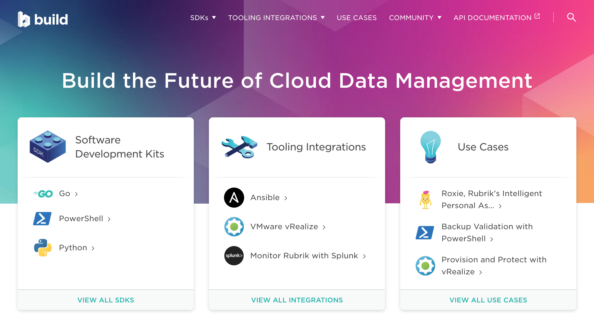

Slide 9

Content Repository
All code, documentation, and community discussion occurs on GitHub.
Each project is stored in its own repository.
Project
Project
Project
Repository
Repository
Repository
rubrikinc Organization

Slide 10
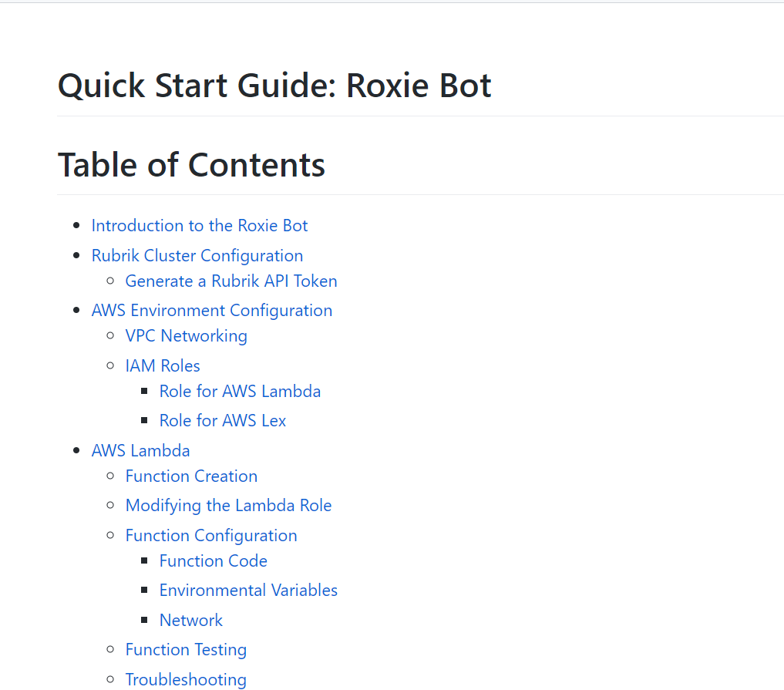
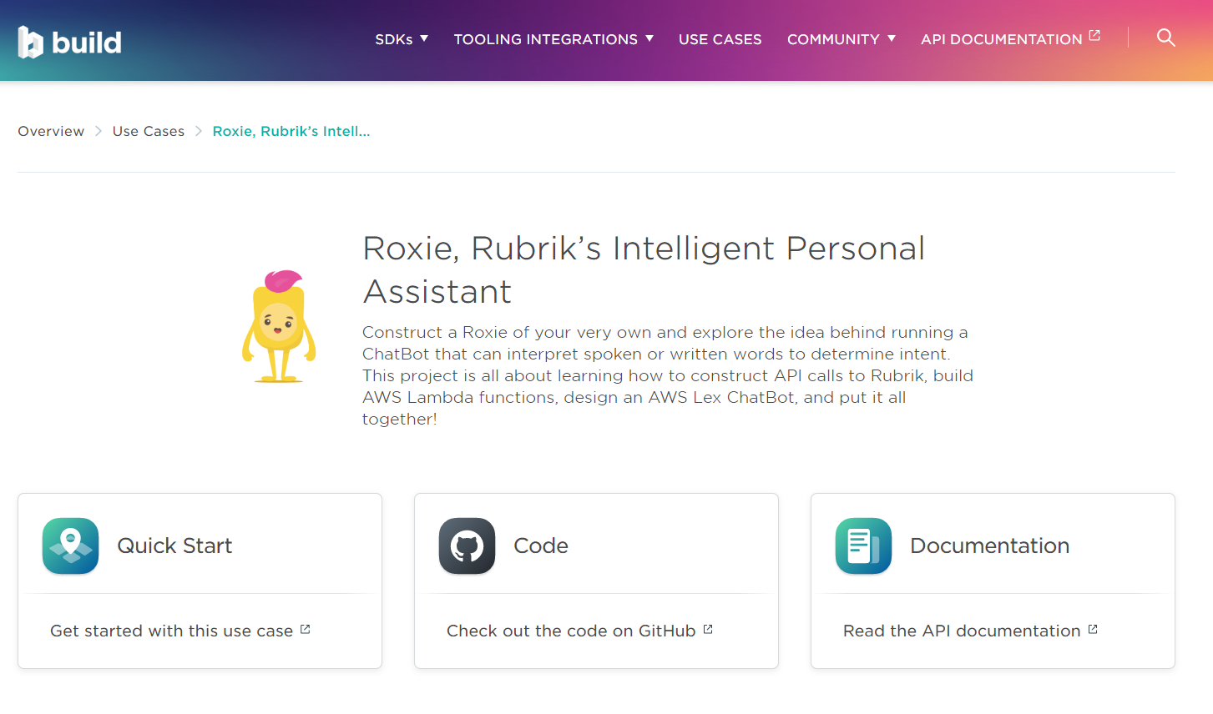
Documentation

Slide 11
Contributing

Slide 12
Code Contributions
Pull Requests (PRs) are used by individuals who wish to contribute to a project. The high level workflow is as follows:
Individual creates a Fork of a Rubrik Build project to their own GitHub account.
Individual makes changes to the Fork copy of the project.
Individual submits a PR requesting that the Rubrik Build project “pull in” their changes.
Issues are also helpful. Help us identify problems!

Slide 13
Non-Code Contributions
Hosting or speaking at meetups
Artistic contributions
Updating existing documentation and adding new features
Translation and localization
GitHub management (tags, issue triage, etc.)

Slide 14
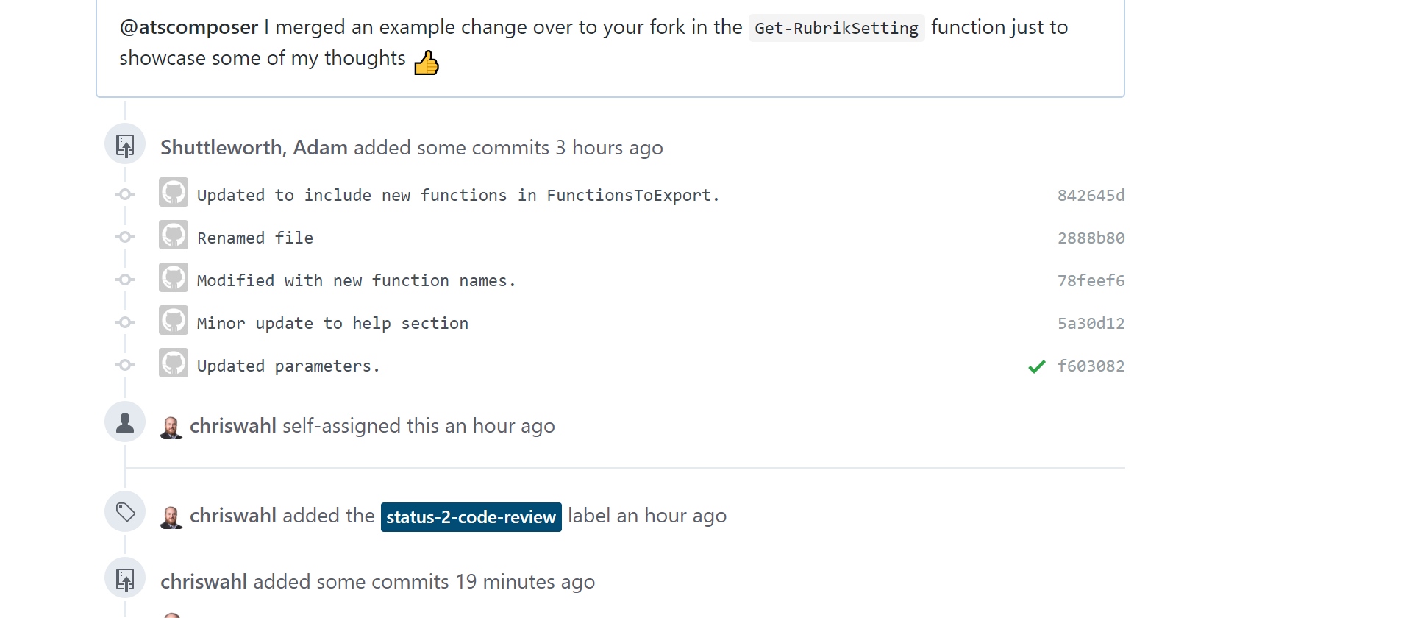
Work Together on Features

Slide 15
As a new Rubrik customer I wanted to be able to set some of these settings and configurations via script and found adding them to the SDK was easier than I thought. :)
“
https://github.com/rubrikinc/rubrik-sdk-for-powershell/pull/263

Slide 16

Use Case Overview Roxie

Slide 17






What are we working with?
Rubrik CDM
Amazon Lex
AWS Lambda
Python
AWS IAM
AWS VPC
Notes:
Lex – Used to build conversational interfaces using voice or text – Utterances tied to Intents

Slide 18
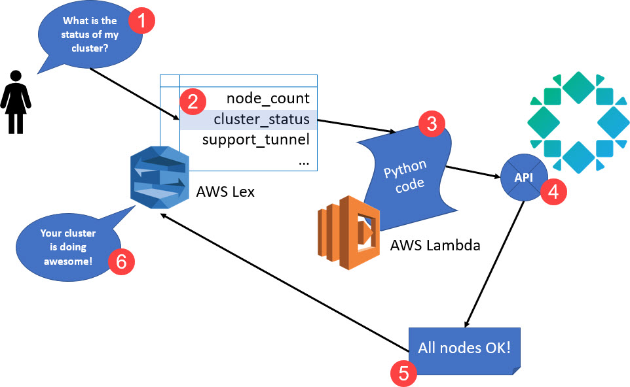
High Level Diagram

Slide 19

Demo Time – A look at Roxie (in the Insight Lab)

Slide 20

Use Case Overview Rubrik As Built Report

Slide 21
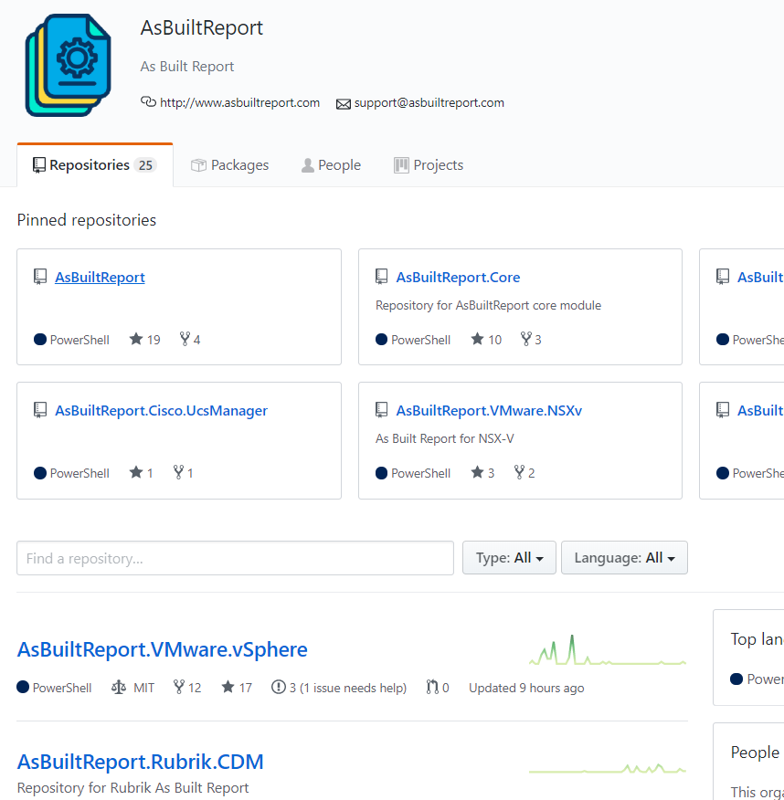
What is the As Built Report project
Open Source Configuration Document Framework created by Tim Carman and Matt Allford
Written in PowerShell
Modular design provides ease of updates
Multiple detail levels for granular control of reports
Multiple output types (HTML, DOCX, XML, & TEXT)

Slide 22
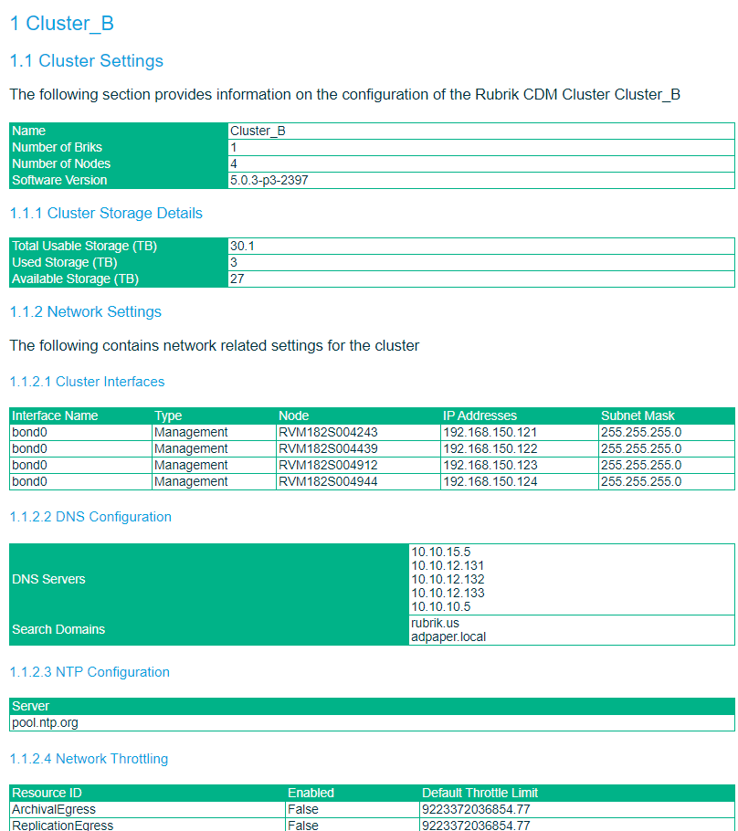
Rubrik As Built Report Module
100% reliant on the Rubrik SDK for PowerShell
Divided into 4 main sections
Cluster Settings – DNS, Network, Security, Users, Storage, etc..
SLA Domains – RPO, Archive, Replication, Object inclusion
Protected Objects – Name, Type, Metadata, Snapshot information
Unprotected Objects – Name, Relic status, Retention status

Slide 23

Demo Time – A look at the Rubrik As Built Report
Today is cable management day in the lab – so, yeah, a video!

Slide 24
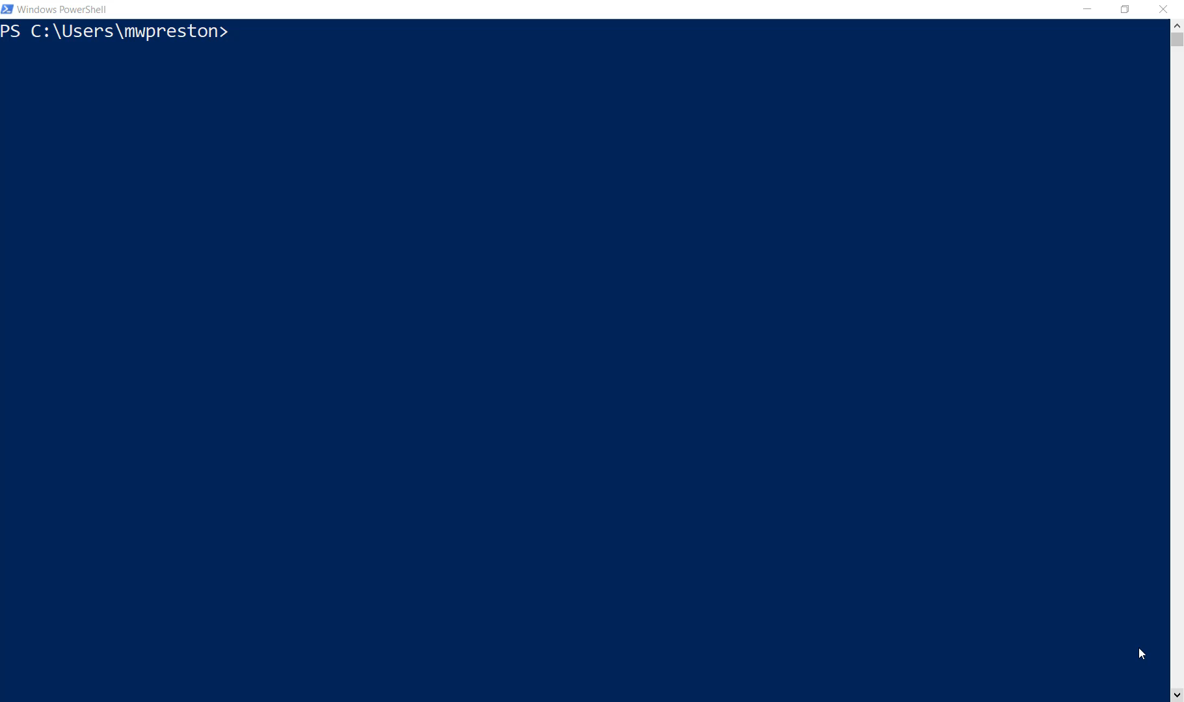

Slide 25
Now What?
Set up Roxie in your own environment
Fork the repo, and add your own functions
Submit a PR and show us your work
Run the As Built Report in your environment
Submit issues on GitHub
More than just Chatbots & Reports – Ansible, PowerShell, Terraform, CloudFormation, ARM, Python….
Join the Rubrik Build Slack channel – https://slack-invite-automation.azurewebsites.net
Password: build
Follow @RoxieAtRubrik and @RubrikBuild

Slide 26
build
Building the Future of Data Management
Slides, Code, & Links all located on https://github.com/mwpreston/presentations

